Slide 1
Topic 11 Heat Engines
Thermodynamics: An Engineering Approach
8th Edition Yunus A. Çengel, Michael A. Boles
McGraw-Hill, 2015

Slide 2
Objectives
Discuss heat engines, refrigerators, and heat pumps.
Describe the Kelvin–Planck and Clausius statements of the second law of thermodynamics.

Slide 3
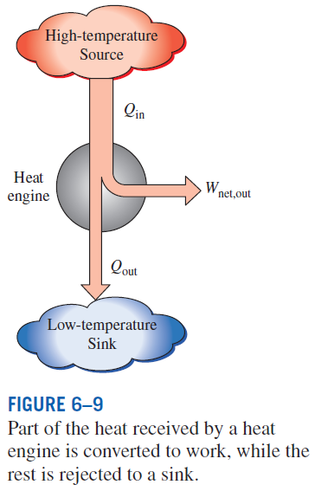
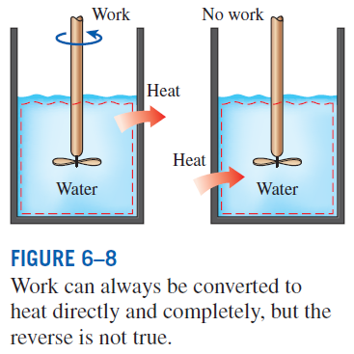
HEAT ENGINES
HEAT ENGINES: The devices that convert heat to work.
They receive heat from a high-temperature source (solar energy, oil furnace, nuclear reactor, etc.).
They convert part of this heat to work (usually in the form of a rotating shaft.)
They reject the remaining waste heat to a low-temperature sink (the atmosphere, rivers, etc.).
They operate on a cycle.
Heat engines and other cyclic devices usually involve a fluid to and from which heat is transferred while undergoing a cycle. This fluid is called the working fluid.

Slide 4
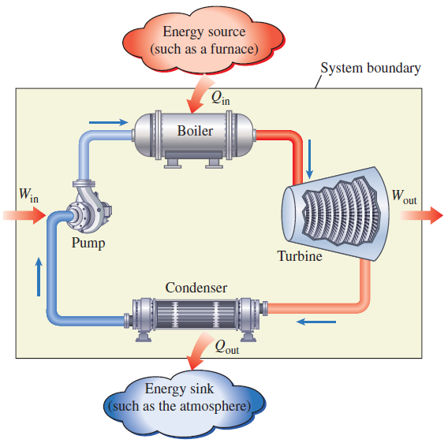
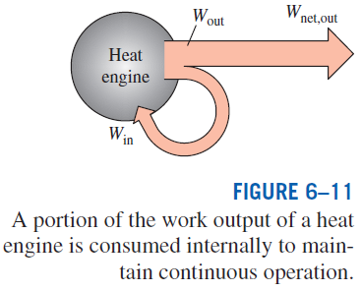
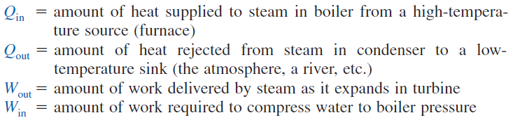
A steam power plant

Slide 5

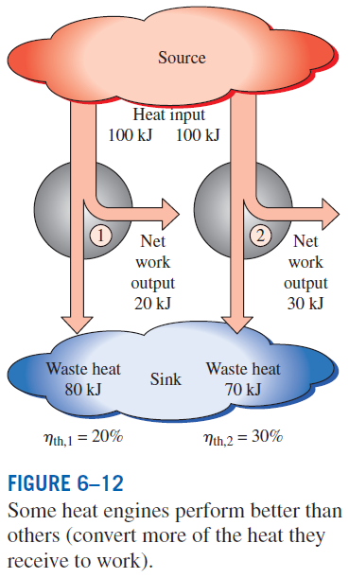
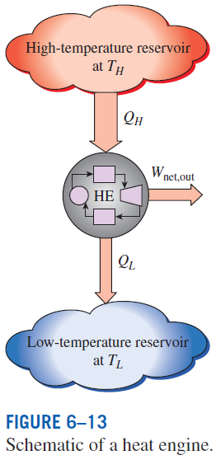



Thermal efficiency

Slide 6
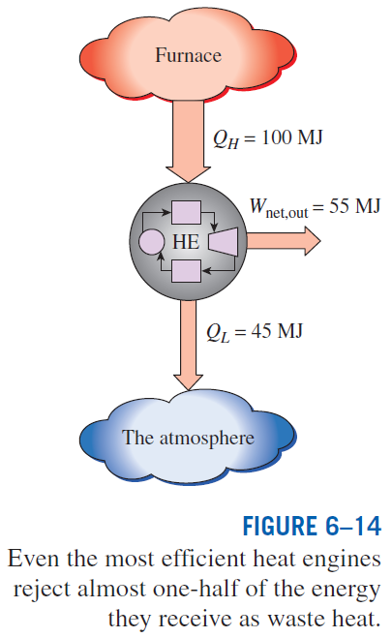
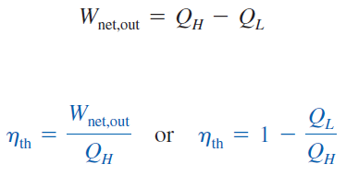

Slide 7
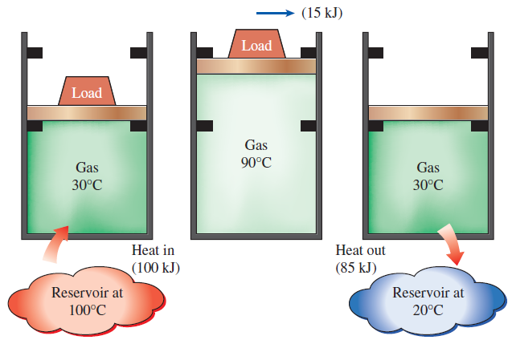
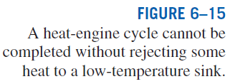
Can we save Q_{out}?
In a steam power plant, the condenser is the device where large quantities of waste heat is rejected to rivers, lakes, or the atmosphere.
Can we not just take the condenser out of the plant and save all that waste energy?
The answer is, unfortunately, a firm no for the simple reason that without a heat rejection process in a condenser, the cycle cannot be completed.
Every heat engine must waste some energy by transferring it to a low-temperature reservoir in order to complete the cycle, even under idealized conditions.

Slide 8
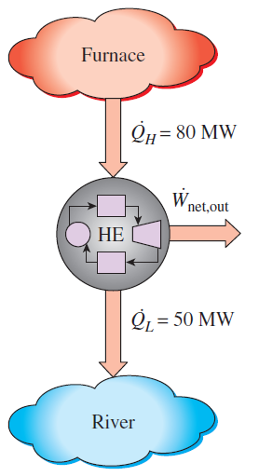
Net Power Production of a Heat Engine
Heat is transferred to a heat engine from a furnace at a rate of 80 MW. If the rate of waste heat rejection to a nearby river is 50 MW, determine the net power output and the thermal efficiency for this heat engine.
Solution

Slide 9
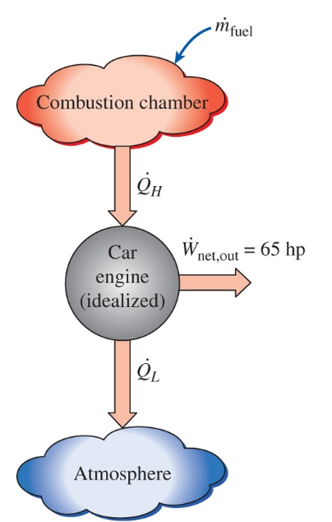
Fuel Consumption Rate of a Car
A car engine with a power output of 65 hp has a thermal efficiency of 24%. Determine the fuel consumption rate of this car if the fuel has a heating value of 19,000 Btu/lbm. (2545 Btu/hr = 1hp)
Solution

Slide 10
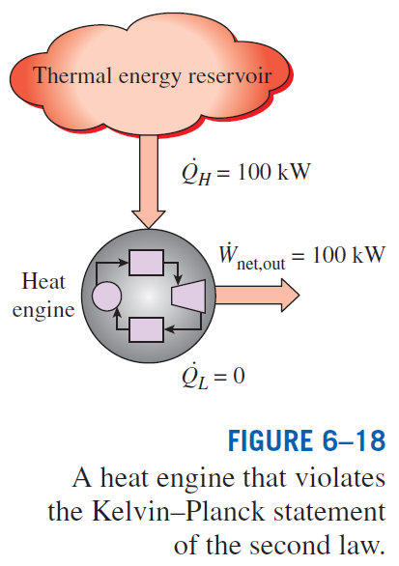
The Second Law of Thermodynamics:
Kelvin–Planck Statement
It is impossible for any device that operates on a cycle to receive heat from a single reservoir and produce a net amount of work.
No heat engine can have a thermal efficiency of 100 percent, or as for a power plant to operate, the working fluid must exchange heat with the environment as well as the furnace.
The impossibility of having a 100% efficient heat engine is not due to friction or other dissipative effects. It is a limitation that applies to both the idealized and the actual heat engines.

Slide 11
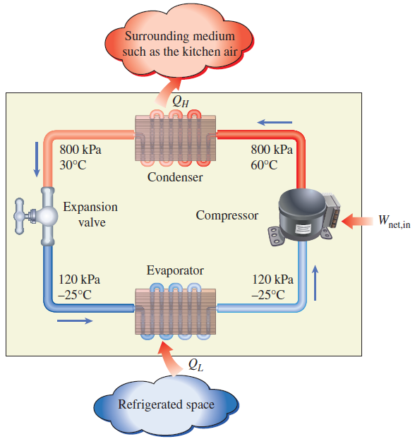
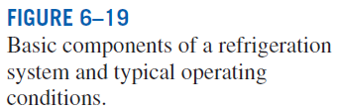
REFRIGERATORS AND HEAT PUMPS
The transfer of heat from a low-temperature medium to a high-temperature one requires special devices called refrigerators.
Refrigerators, like heat engines, are cyclic devices.
The working fluid used in the refrigeration cycle is called a refrigerant.
The most frequently used refrigeration cycle is the vapor-compression refrigeration cycle.
In a household refrigerator, the freezer compartment where heat is absorbed by the refrigerant serves as the evaporator, and the coils usually behind the refrigerator where heat is dissipated to the kitchen air serve as the condenser.

Slide 12
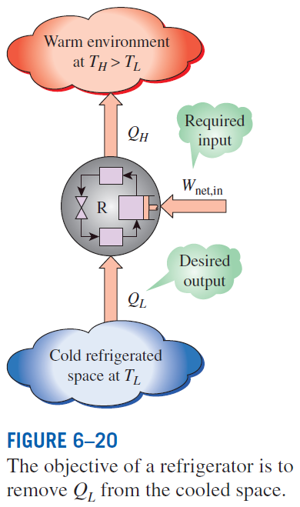
Coefficient of Performance
The efficiency of a refrigerator is expressed in terms of the coefficient of performance (COP).
The objective of a refrigerator is to remove heat (Q_{L}) from the refrigerated space.
Can the value of COP_{R} be greater than unity?

Slide 13
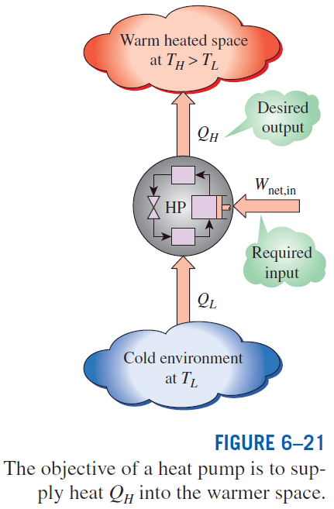



Heat Pumps
for fixed values of Q_{L} and Q_{H}
Can the value of COP_{HP} be lower than unity?
What does COP_{HP}=1 represent?

Slide 14
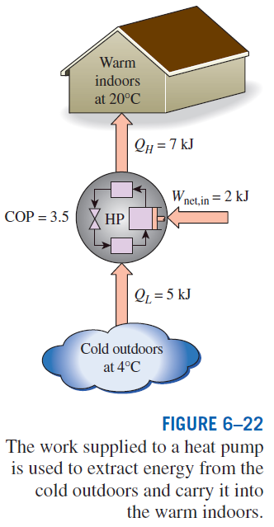

Most heat pumps in operation today have a seasonally averaged COP of 2 to 3.
Most existing heat pumps use the cold outside air as the heat source in winter (air-source HP).
In cold climates their efficiency drops considerably when temperatures are below the freezing point.
In such cases, geothermal (ground-source) HP that use the ground as the heat source can be used.
Such heat pumps are more expensive to install, but they are also more efficient.
Air conditioners are basically refrigerators whose refrigerated space is a room or a building instead of the food compartment.
The COP of a refrigerator decreases with decreasing refrigeration temperature.
Therefore, it is not economical to refrigerate to a lower temperature than needed.
Energy efficiency rating (EER): The amount of heat removed from the cooled space in Btu’s for 1 Wh (watthour) of electricity consumed.

Slide 15
Heat Rejection by a Refrigerator
The food compartment of a refrigerator is maintained at 4ºC by removing heat from it at a rate of 360 kJ/min. If the required power input to the refrigerator is 2 kW, determine the coefficient of performance of the refrigerator and the rate of heat rejection to the room that houses the refrigerator.
Solution

Slide 16
Heating a House by a Heat Pump
A heat pump is used to meet the heating requirements of a house and maintain it at 20ºC. On a day when the outdoor air temperature drops to -2ºC, the house is estimated to lose heat at a rate of 80,000 kJ/hr. If the heat pump under these conditions has a COP of 2.5, determine the power consumed by the heat pump and the rate at which heat is absorbed from the cold outdoor air.
Solution

Slide 17
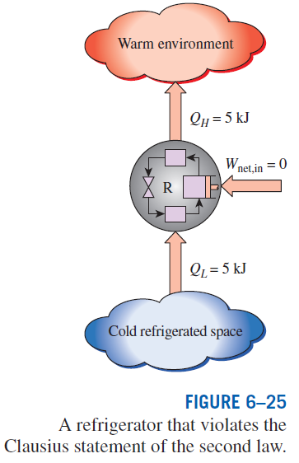
The Second Law of Thermodynamics: Clausius Statement
It is impossible to construct a device that operates in a cycle and produces no effect other than the transfer of heat from a lower-temperature body to a higher-temperature body.
It states that a refrigerator cannot operate unless its compressor is driven by an external power source, such as an electric motor.
This way, the net effect on the surroundings involves the consumption of some energy in the form of work, in addition to the transfer of heat from a colder body to a warmer one.
To date, no experiment has been conducted that contradicts the second law, and this should be taken as sufficient proof of its validity.

Slide 18
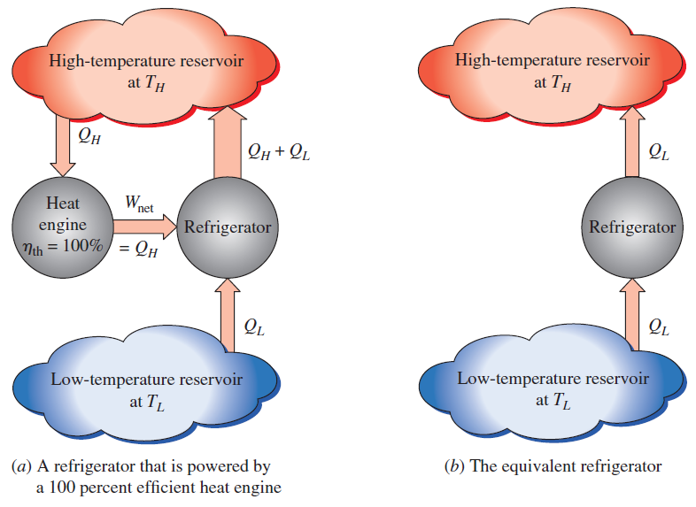
Equivalence of the Two Statements
Proof that the violation of the Kelvin–Planck statement leads to the violation of the Clausius statement.
The Kelvin–Planck and the Clausius statements are equivalent in their consequences, and either statement can be used as the expression of the second law of thermodynamics.
Any device that violates the Kelvin–Planck statement also violates the Clausius statement, and vice versa.

Slide 19
Summary
Heat engines
Thermal efficiency
The 2nd law: Kelvin-Planck statement
Refrigerators and heat pumps
Coefficient of performance (COP)
The 2nd law: Clausius statement

